Slide 1




Greedy Dwarf
“A Dwarf Steals as Much Treasure as He Can Without Getting Caught by the Dragon”
Alyssa Mihok, Jazbel Lopez, Ivana Pavlovic

Slide 2
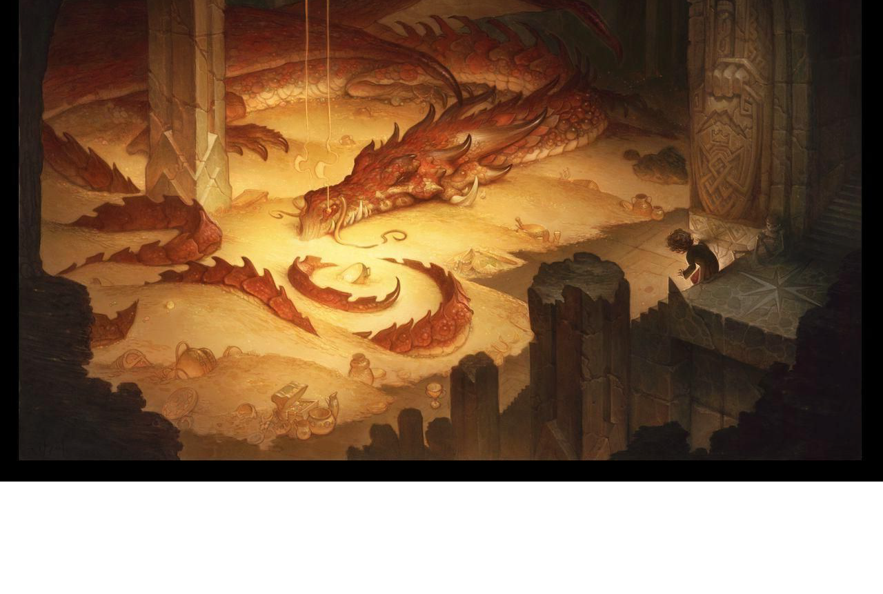
Original Creators
Aaron Lau
Christian Rivera
Matthew Searcy

Slide 3
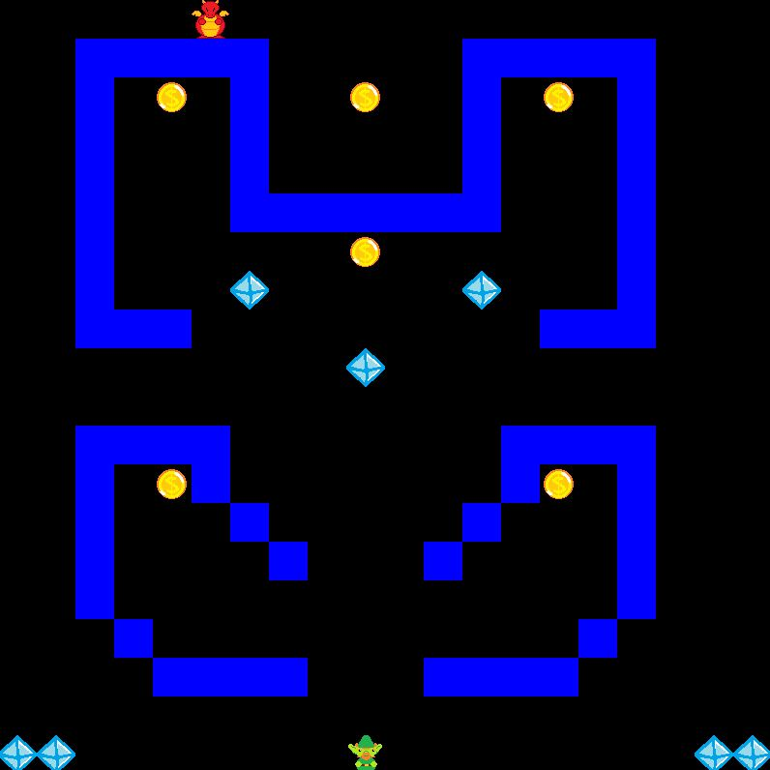
Purpose of the Game
Public piece of entertainment
Better Players skills
Created for profit

Slide 4


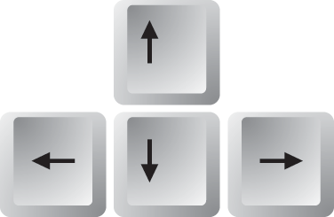
Game rules
How to play?
How to increase your score?
How to win?

Slide 5
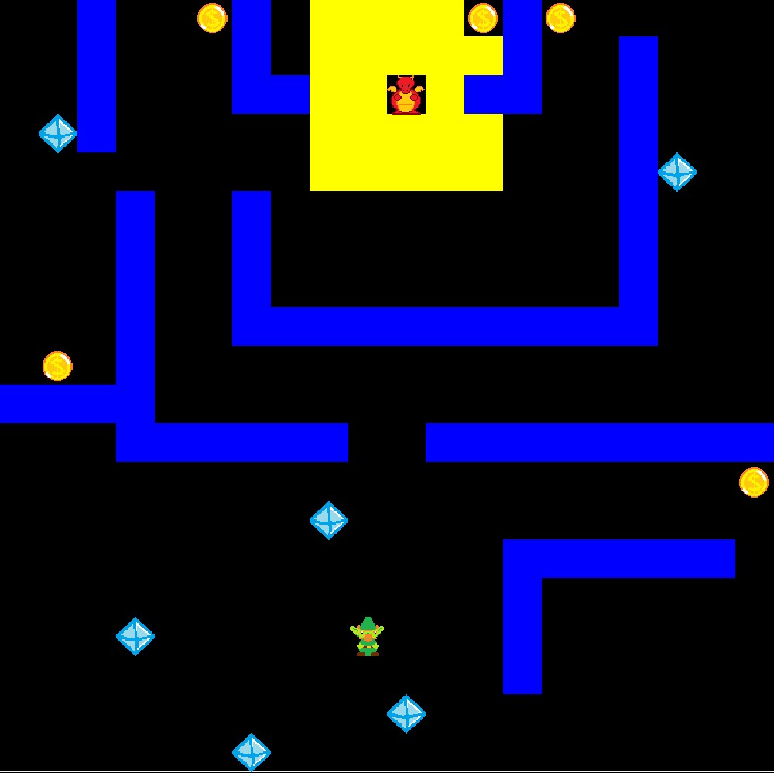

Slide 6
Dragon Range
More complex than Line of Sight
Area around the dragon that will activate the chase function without having treasure

Slide 7

Death and Save
Press ‘S’ at any time during an active game to save your file
Every time the dragon “catches” the dwarf: Lose 5 of your current points!
If current points reaches 0: GAME OVER

Slide 8
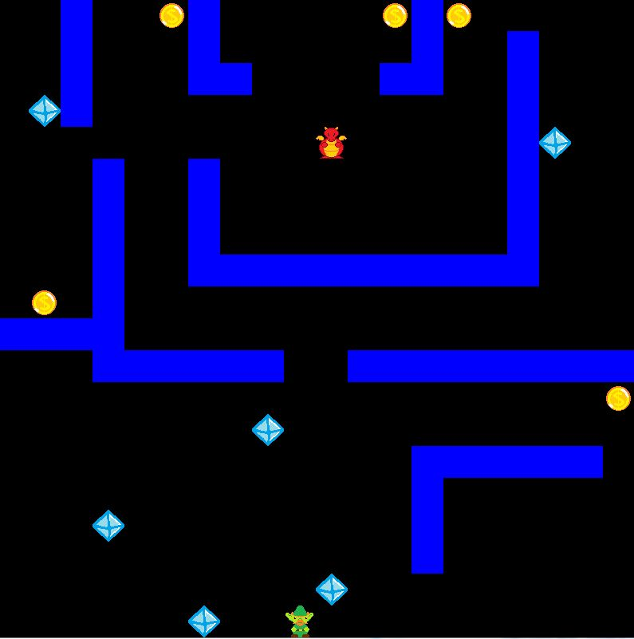
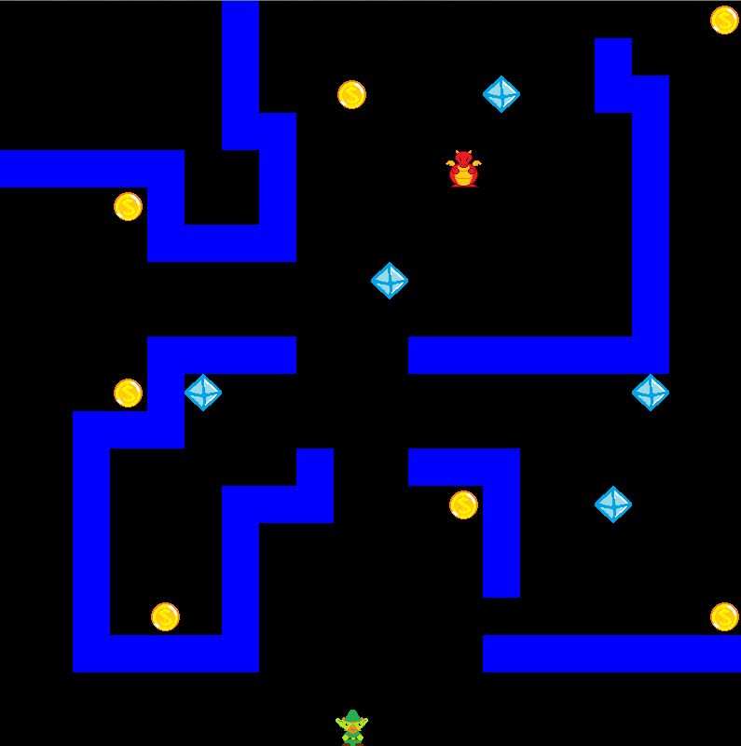
Potential Additions
Power ups
Hammer for fighting
Shield to reduce damage
Cloak to make you invisible
Music/Sound effects
More or randomized levels

Slide 9
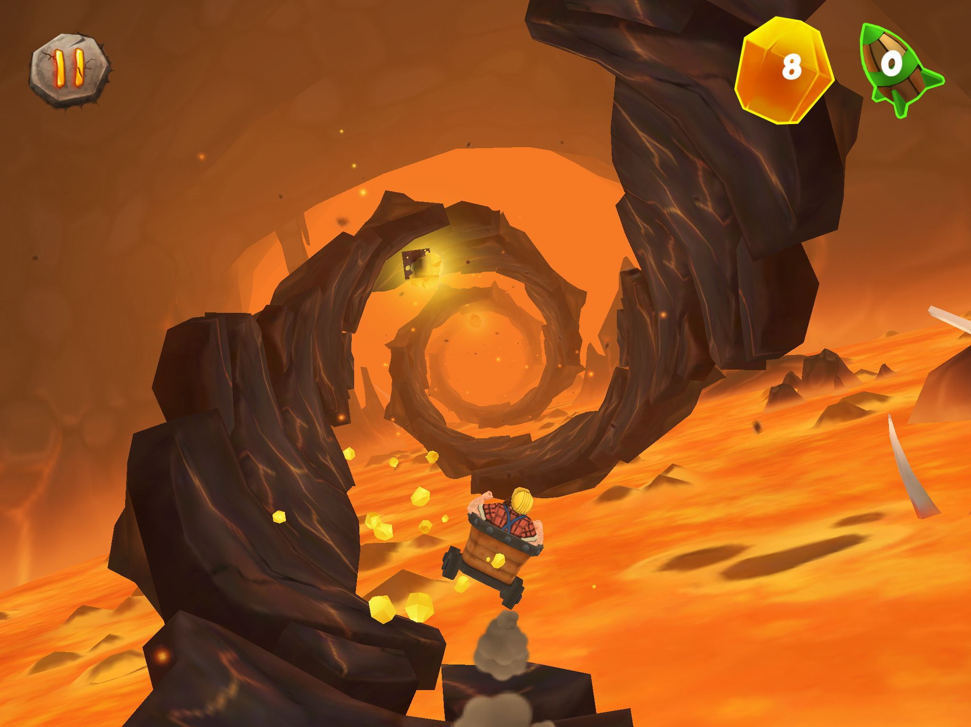

What’s out there
Improvements:
Up our graphics. Since we are at the beginning stages we would want to up the graphics with competing games

